Slide 1
The Role of Variability in Learning Generalization: A Computational Modeling Approach
Thomas Gorman

Slide 2
Learning Generalization
Learning is often specific
Longstanding scientific interest in how to improve generalization or transfer

Slide 3
Variability
Variation during training linked to improved transfer in numerous domains
What does “variability mean in the context of learning interventions?”
Types of Variability
The number of unique items/problems experienced
How spread out examples are
My Dissertation Focus
Number of unique examples
Visuomotor skill learning and function learning
Addressing methodological shortcomings of previous work
Adapting cognitive models from other domains to account for results

Slide 4
Common Experimental Manipulations
Varied vs. Constant
Common Empirical Patterns

Slide 5
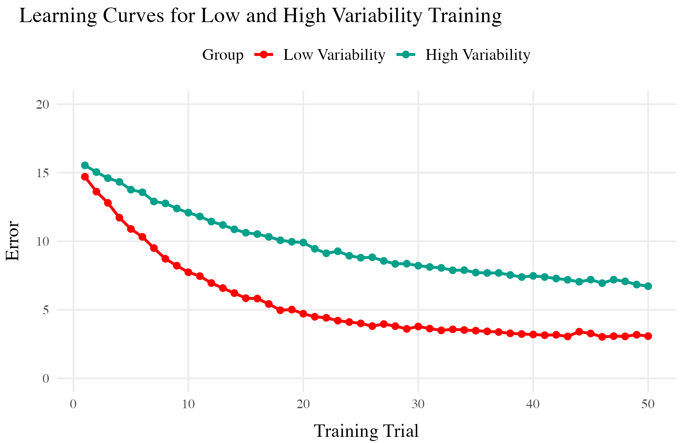
Training
Both training conditions complete the same number of training trials.
Varied group has worse training performance.
Testing
Tested from novel conditions.
Varied group has better test performance

Slide 6
But also plenty of contradictory results and complications
Cases where varied training doesn’t benefit generalization
Cases where more training variation results in worse outcomes
Cases where the influence of variation interacts with some other factor
difficulty
prior knowledge
Frequency effects, or amount of training/learning before testing

Slide 7
Overview
Project 1
Visuomotor projectile launching task
two experiments
Beneficial effect of variability
Instance-based similarity model
Project 2
Visuomotor extrapolation task
Three experiments
Effect of variability is null or negative
Connectionist model (ALM) and hybrid associative & rule model (EXAM)

Slide 8
Project 1
An instance-based model account of the benefits of varied practice in visuomotor skill¹

Slide 9
Theoretical Frameworks
Desirable Difficulties Framework (Bjork & Bjork, 2011)
Challenge Point Framework (Guadagnoli & Lee, 2004)
Schema Theory (Schmidt, 1975)
Schmidt (1975) Bjork & Bjork (2011) Guadagnoli & Lee (2004)
Notes:
Variety of theoretical explanations Schema theory in paticular has been extremely influential

Slide 10
Issues with previous research
Assumptions about what is encoded
Assumptions about the formation of abstractions
Aggregation issues and similarity confounds
If generalization decays exponentially with distance, constant groups 1 and 2 may have far less generalization potential to the testing condition.
performance of individual constant groups often not reported in analyses.
e.g. (Chua et al., 2019; Del Rey et al., 1982; McCracken & Stelmach, 1977)

Slide 11
Designs that avoid similarity issue
Kerr & Booth 1978

Slide 12
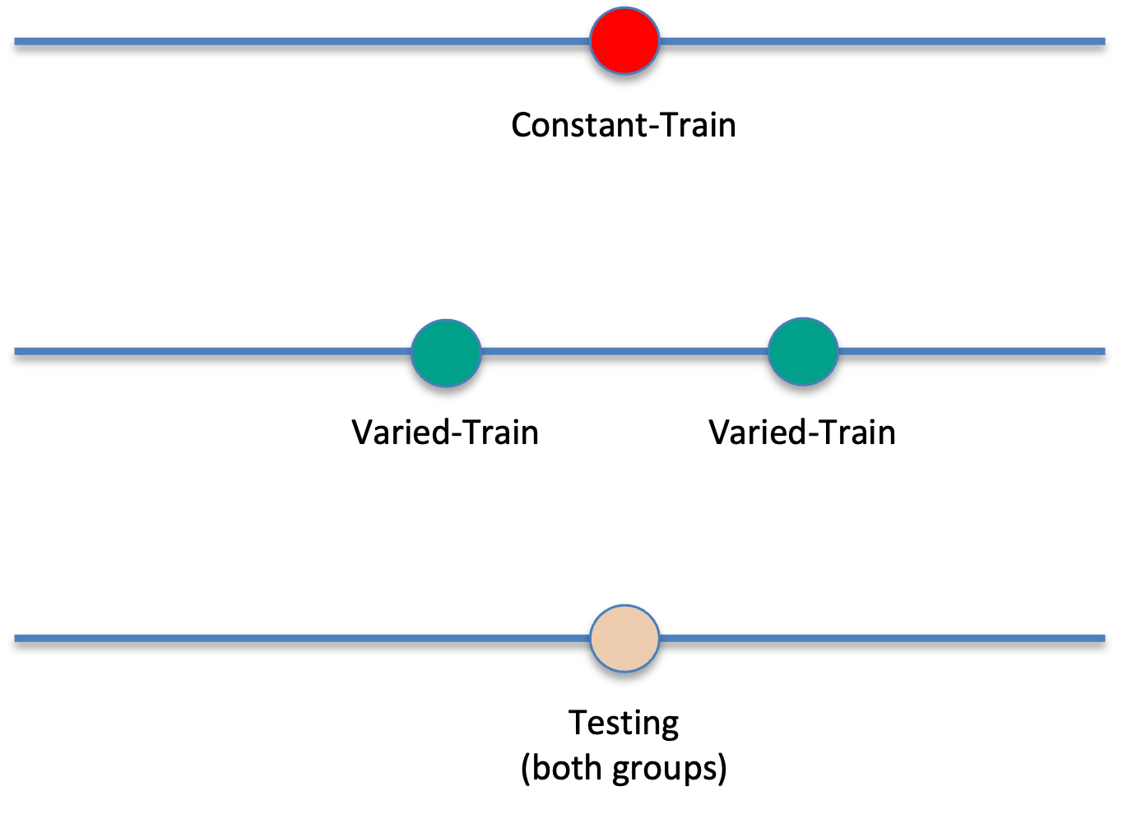
Bean bag tossing task
Constant and varied conditions train from distinct positions
Both groups are tested from the position where the constant group trained
Impressive demonstration of varied training outperforming constant training

Slide 13
Kerr & Booth (1978)

Slide 14
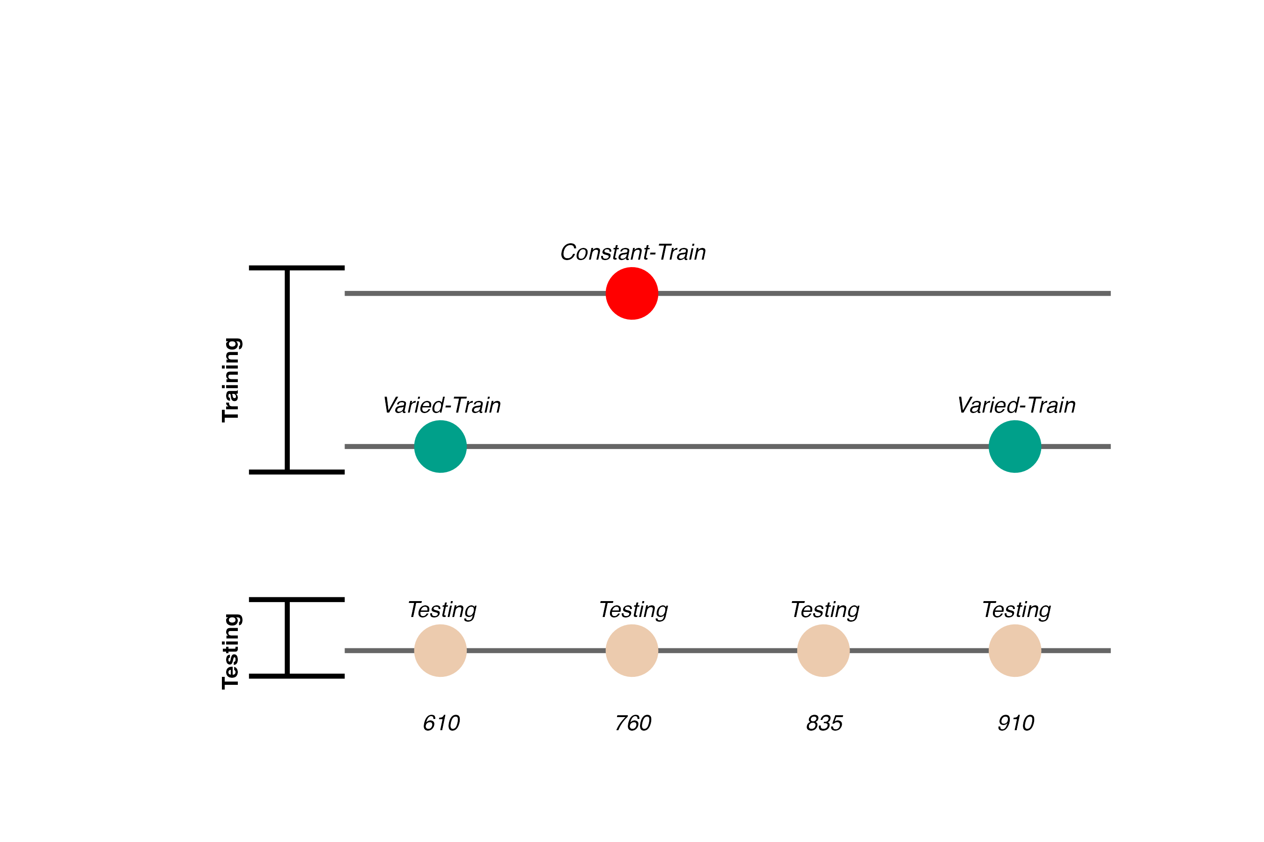
Experiment 1
Conceptual replication of Kerr & Booth design
Also test positions novel to both groups
Validate computerized visuomotor learning task
Experiment 1 Design

Slide 15
Constant trains from one position (760)
200 trials
Varied trains from two positions (610 and 910)
100 trials per position
Both groups are tested from all three training positions, and a new position novel to both groups (835)

Slide 16
Hit The Target Task
Training Stage - 200 training trials with feedback. Constant groups trains from single position. Varied group practices from two positions.
Transfer Stage - All subjects tested from both positions they were trained, and the positions trained by other group
Data recorded - For every throw, recorded the X velocity and Y velocity of ball at release
Notes:
Use mouse to flick the ball towards the target
Must release from orange square
Subjects have flexibility in terms of trajectory and release point inside the square
Nicety of computerized task - we record the precise details easily

Slide 17
Project 1 - Experiment 1 Results

Slide 18
Training
Testing
Notes:
Varied training significantly better at the position that was novel for all subjects. Also better even at the position that the constant group trained at.
4 different positions, the varied group trained from the easiest and the hardest position, they also interpolated the constant group.

Slide 19
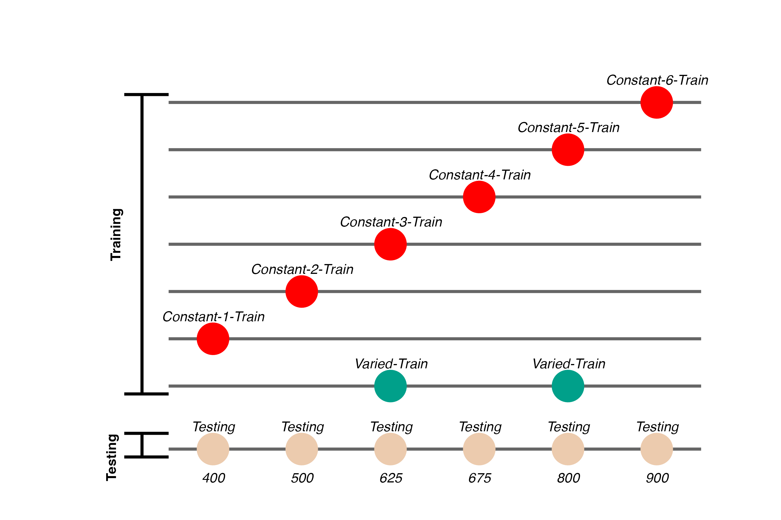
Experiment 2 Design
Notes:
task mostly the same - minor adjustments to barrier 6 different constant groups varied group doesn’t train on either the easiest or the hardest position
larger design to give us more data to work with for modelling

Slide 20
Project 1 - Experiment 2 Results

Slide 21
Training
Testing
Notes:
This time we can compare varied and constant training - by just comparing the varied group to the 2 constant groups that trained at the same locations
Here we have all 6 of the constant groups collapsed together
also did more fine grained grained comparisons

Slide 22
Project 1 Computational Model
Instance encoding, and similarity-based generalization assumptions
Instances refers to individual throws (x and y velocity)
Similarity refers to the distance between training throws and the solution space of each of the eventual testing positions.

Slide 23
Project 1 Computational Model

Slide 24
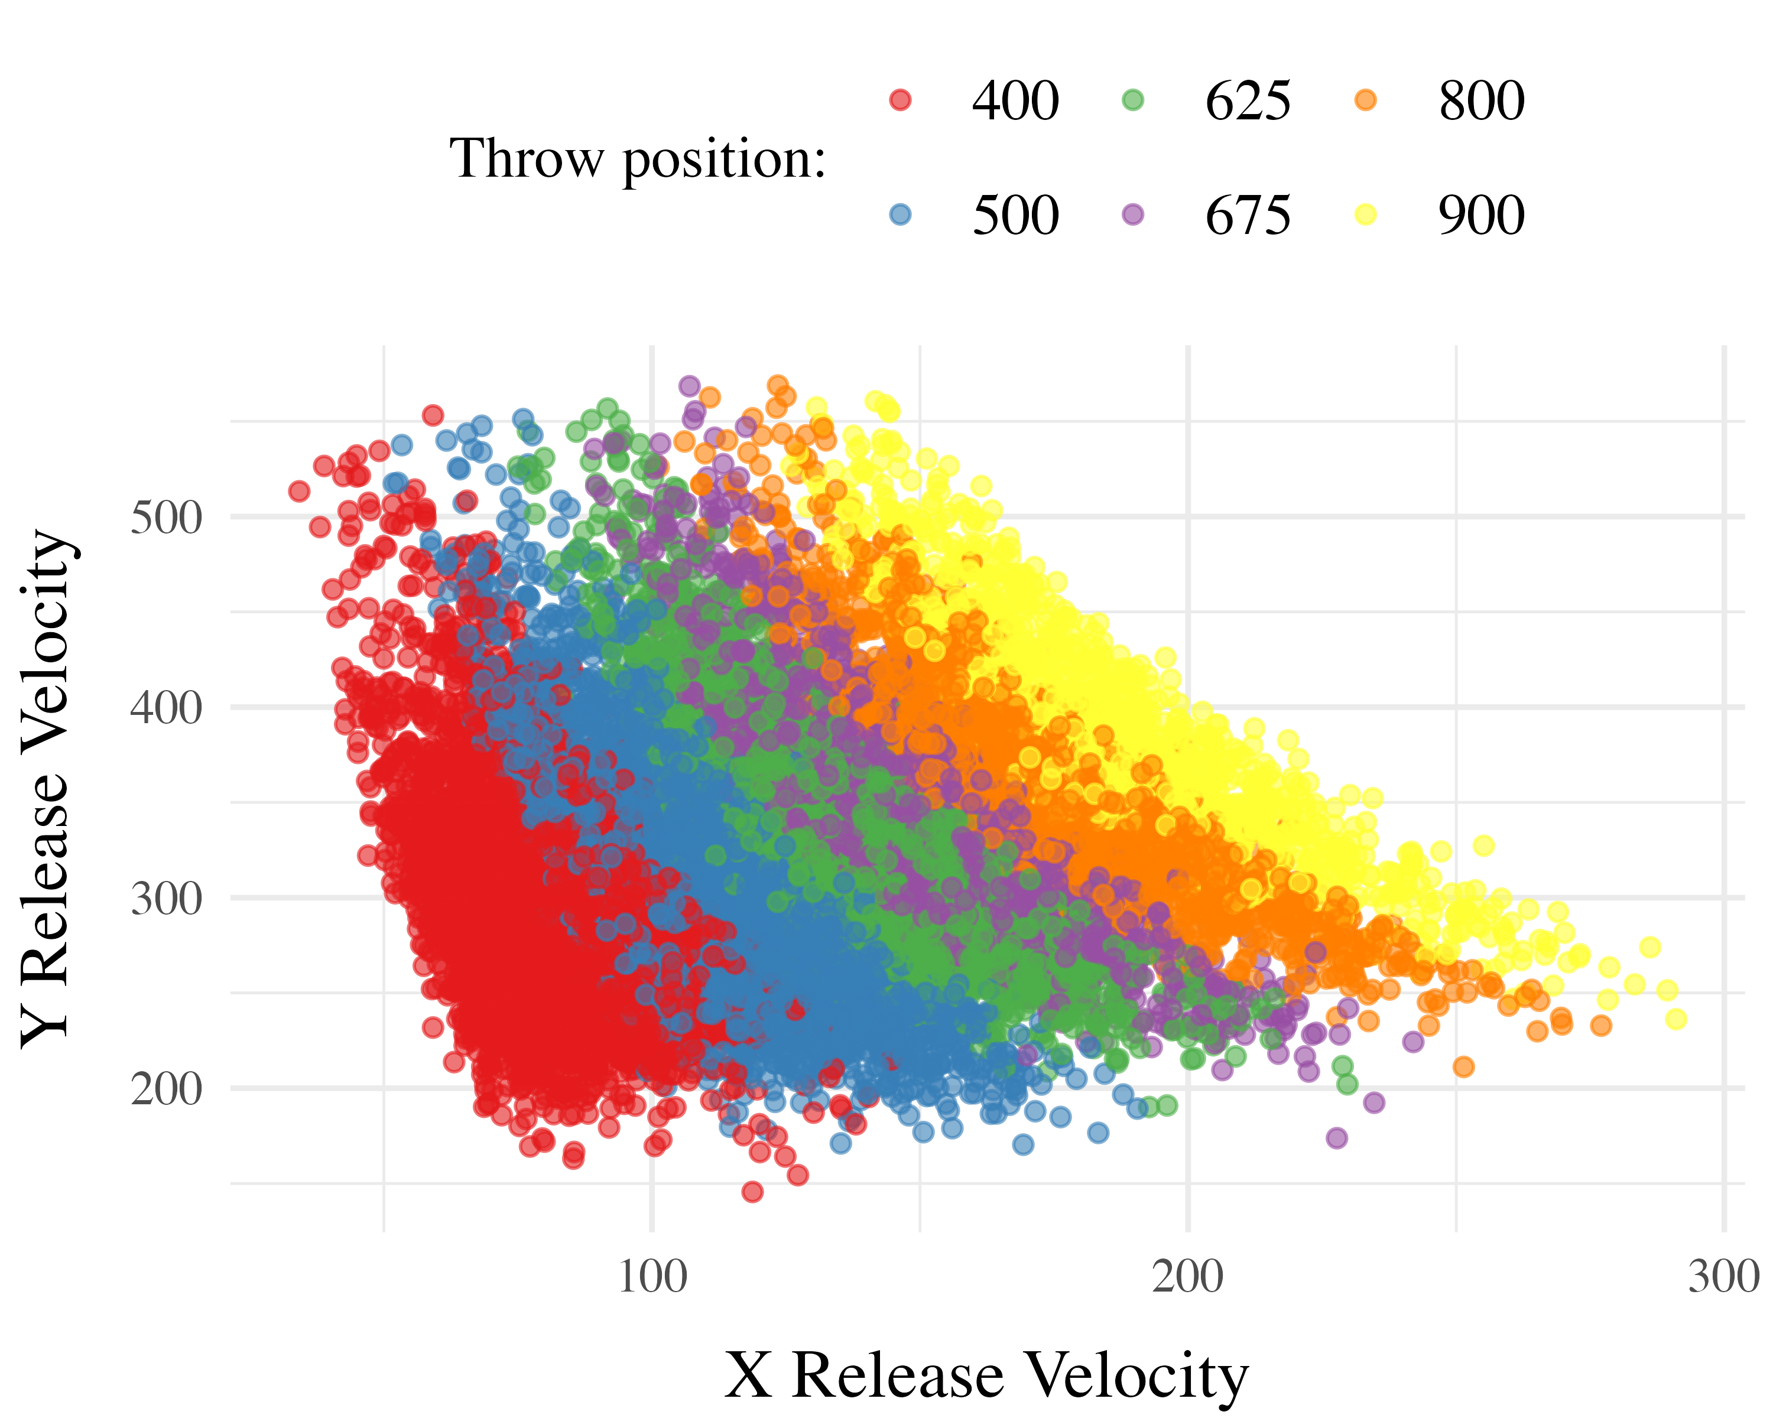
Computing Similarity
Euclidean distance between each training throw, and each solution space
separately for each participant, and each of the testing positions
Similarity computed as a Gaussian decay function of distance, i.e. larger distances result in lower similarity
Each participant gets their own similarity score for each of the 6 testing positions
similarity score for a given testing position is the sum of the similarities between each training throw and the entire empirical solution space
Model Definition
$d_{i,j}=\sqrt{{\left(x_{Train_{i}}−x_{Solution_{j}}\right)}^{2}+{\left(y_{Train_{i}}−y_{Solution_{j}}\right)}^{2}}$
SimilarityI,J=i=I​j=J​e−c⋅di,jp

Slide 25
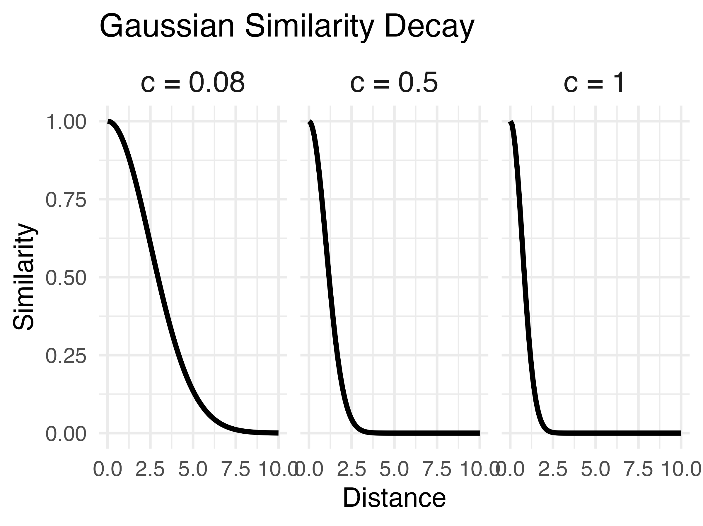
Non-linear similarity

Slide 26
Does this similarity metric work?
Our similarity measure does is a significant predictor of testing performance.
Remains significant when controlling for training accuracy, and training condition.

Slide 27
Accounting for group-level effect
The base version of the model fit a single $c$ parameter
thus assuming that everyone generalizes to the same degree
We next fit a 2-c version, separately optimizing for varied and constant groups, resulting in new 2-c similarity scores for each participant.
The optimal c value for the varied group is smaller than that of the constant group, indicative of broader generalization.
When 2-c similarity is added to the linear model predicting testing performance as a function of condition, the effect of training condition is no longer significant.
not the case with the original 1-c similarities.
Thus the influence of varied training can be explained by an instance-based similarity model, IF one assumes flexibility in the generalization gradient.
Conclusions
New empirical support for a benefit of variability in visuomotor skill tasks
Some support for the less common pattern observed by Kerr & Booth (1978)
Demonstrated the utility of a similarity based approach in this domain

Slide 28
Project 2

Slide 29
Project 2
Impact of Training Variability on Visuomotor Function Learning and Extrapolation
Influence of varied practice in a function learning task
Experiments 1, 2, and 3:
Training regimes and testing conditions
Learning, discrimination, and extrapolation performance metrics

Slide 30
Project 2 - Questions and Goals
Empirical - Design a task-space large enough to assess multiple degrees of extrapolation - Compare varied and constant generalization from several distinct distances from their nearest training condition
Model-based - If variation does influence extrapolation, can an associative learning model with similarity-based activation provide a good account? - Can our modelling framework simultaneously account for both training and testing data? - Accounting for the full distribution of responses

Slide 31
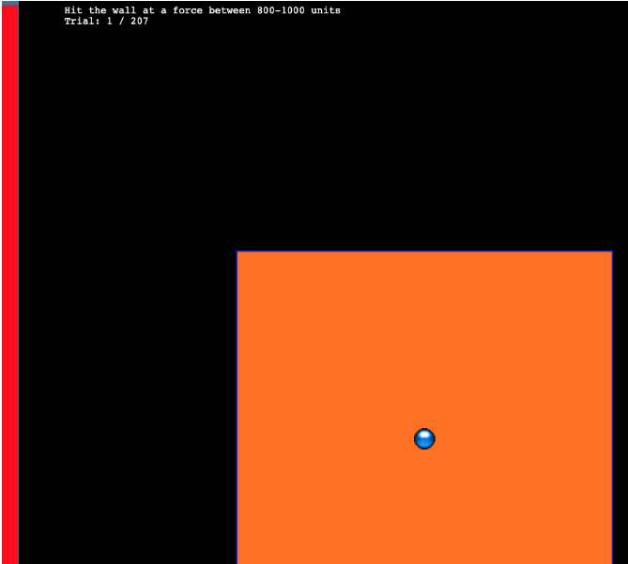
Hit The Wall Task

Slide 32
Target velocity presented at top of screen
Participants attempt to “hit the wall” at the correct velocity
Feedback during training - how many units above or below the target-band
Only the “x velocity” component of the throw is relevant to the task

Slide 33
Project 2 - Experiment 1 Design

Slide 34
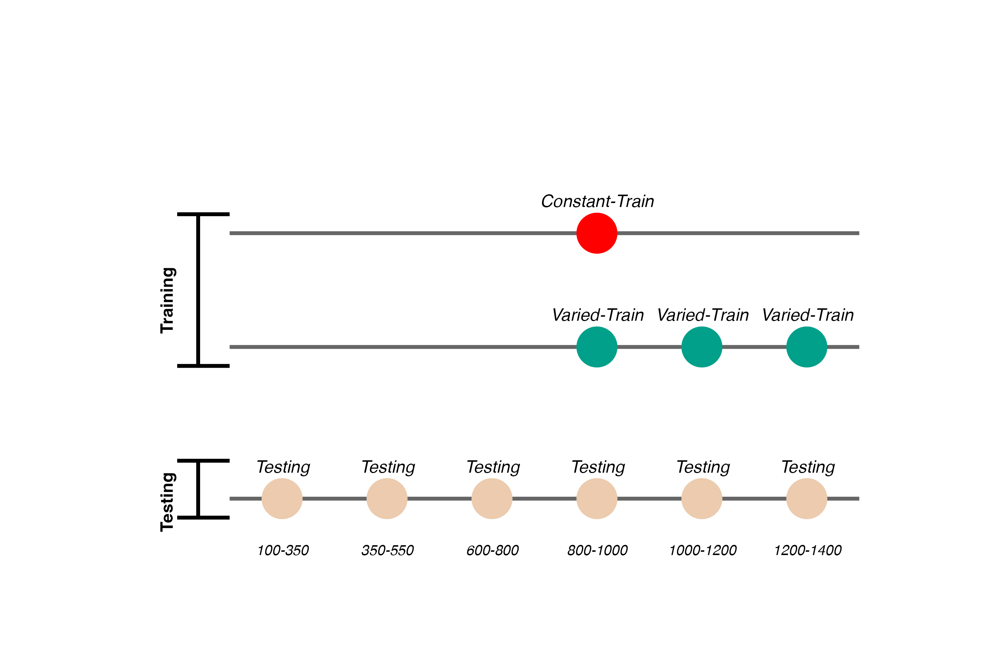
156 participants included in final analysis
Varied group trains from 3 “velocity bands”, constant group from 1
Both groups complete same total number of training trials

Slide 35
Project 2 - Experiment 1 Results

Slide 36
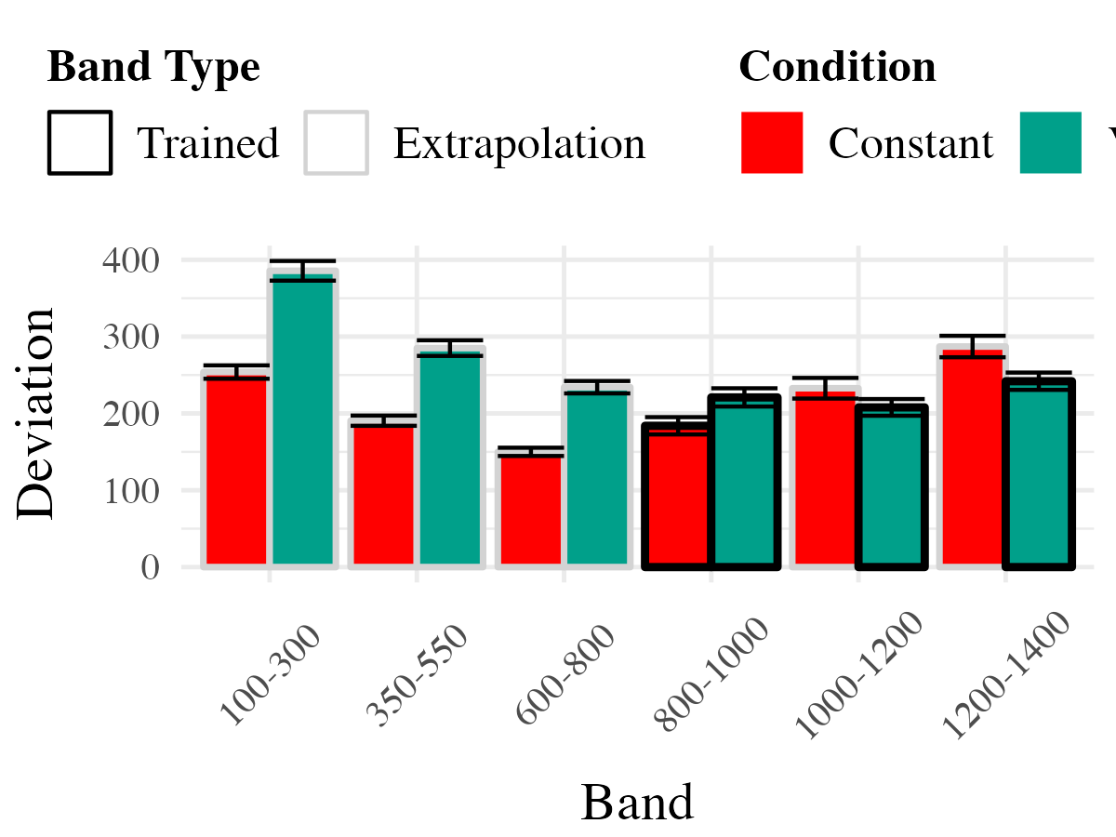
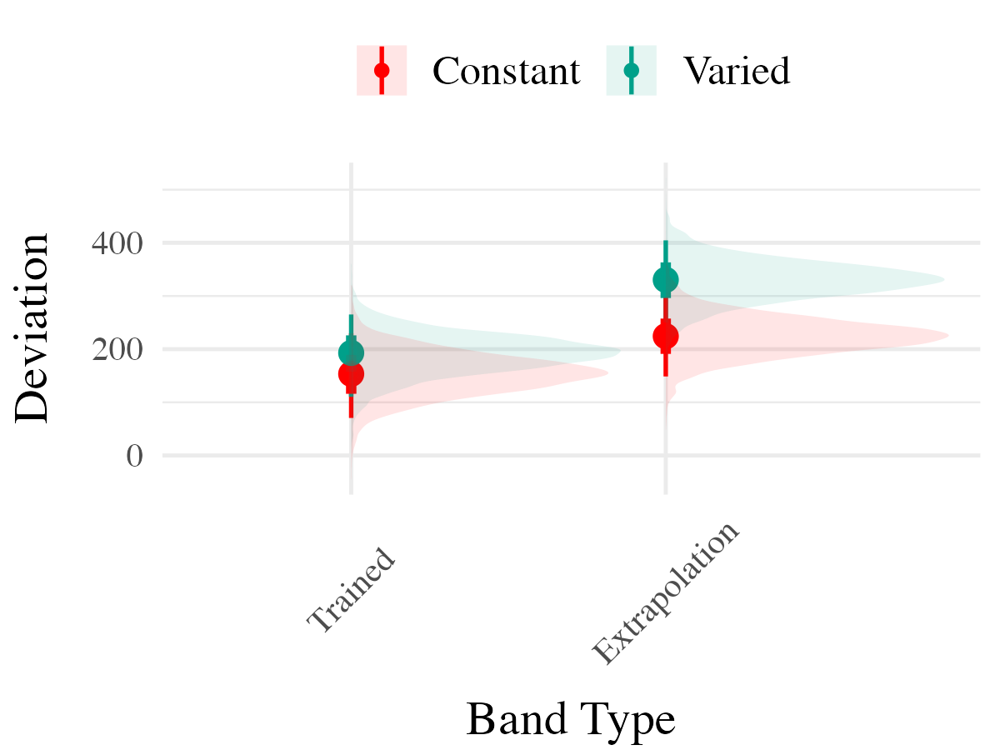

Slide 37
Project 2 - Experiment 2 Design

Slide 38
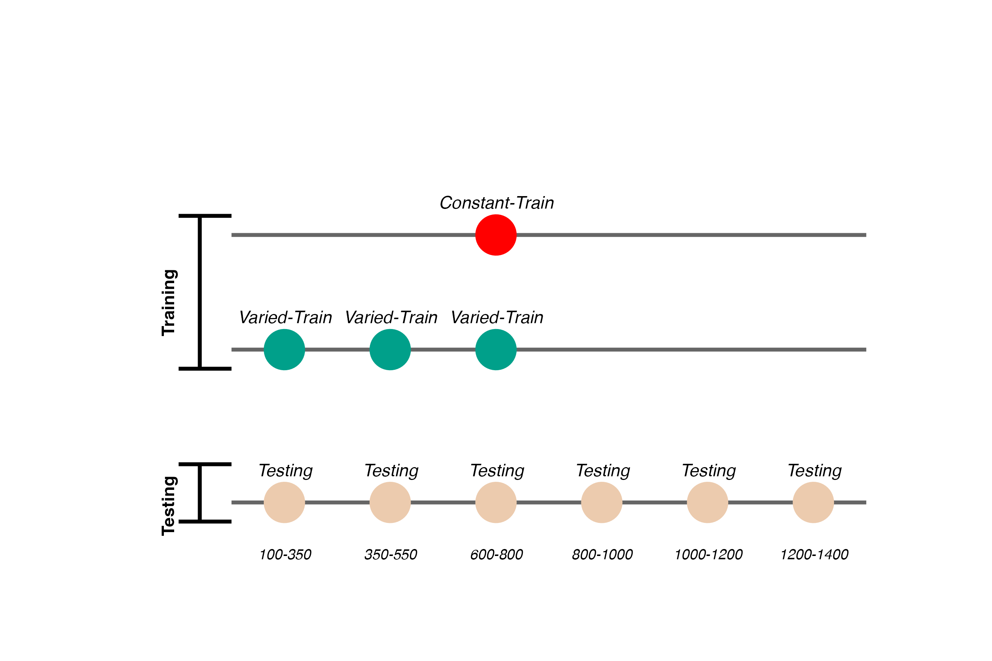
Training and Testing bands are in reversed order, relative to Experiment 1
110 participants included in final analysis

Slide 39
Project 2 - Experiment 2 Results

Slide 40
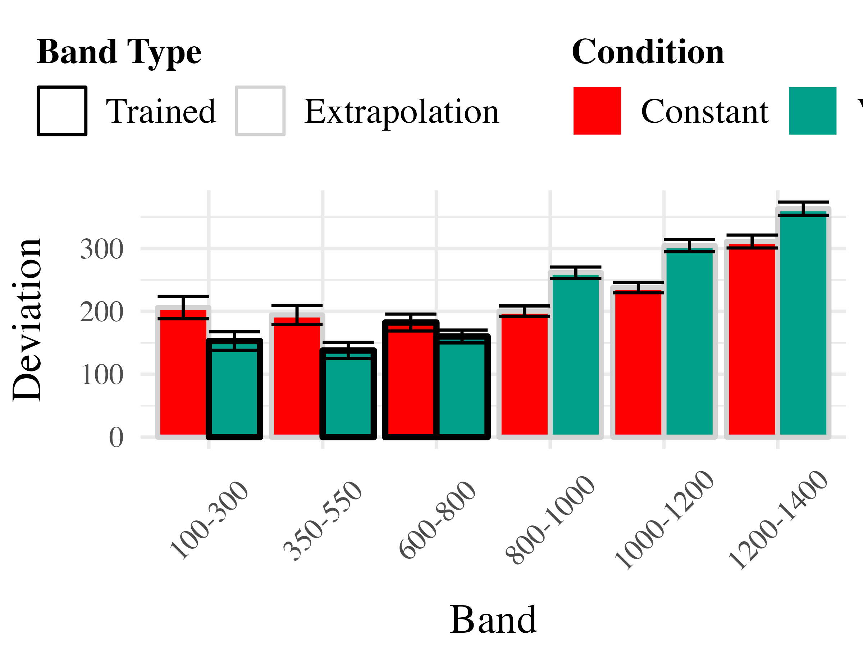
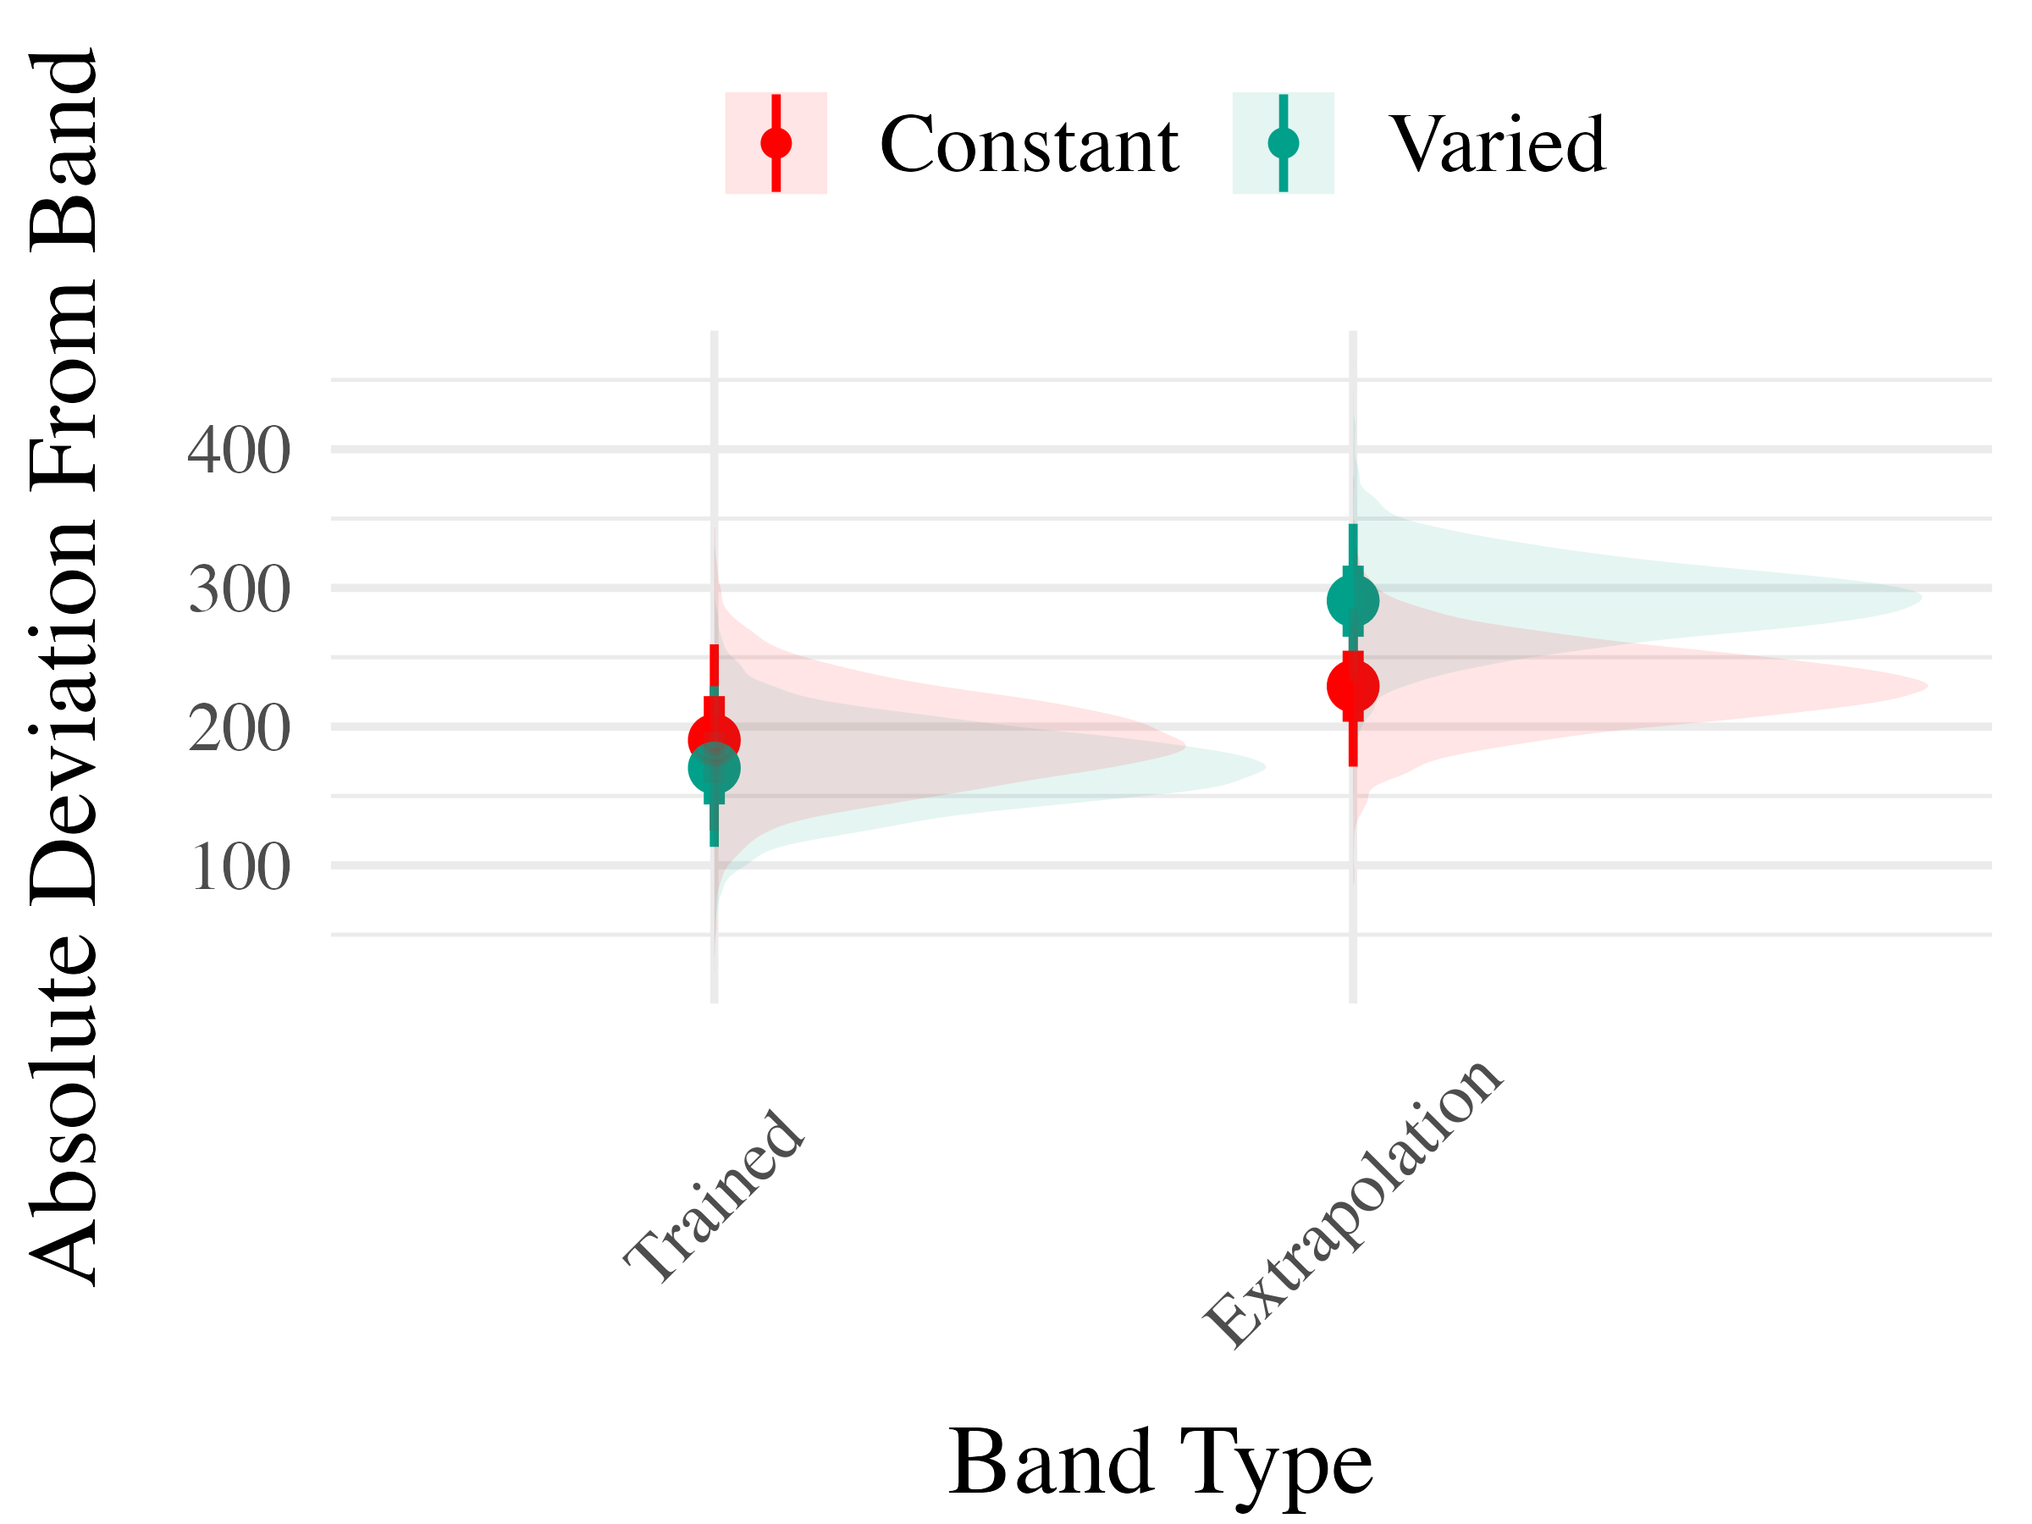

Slide 41
Project 2 - Experiment 3
Ordinal Feedback
directional feedback indicating too high, too low, or correct
Both Original (Experiment 1), and reverse (Experiment 2) orders included
195 participants included in final analysis
Project 2 - Experiment 3 Results
Experiment 3 - Accuracy

Slide 42
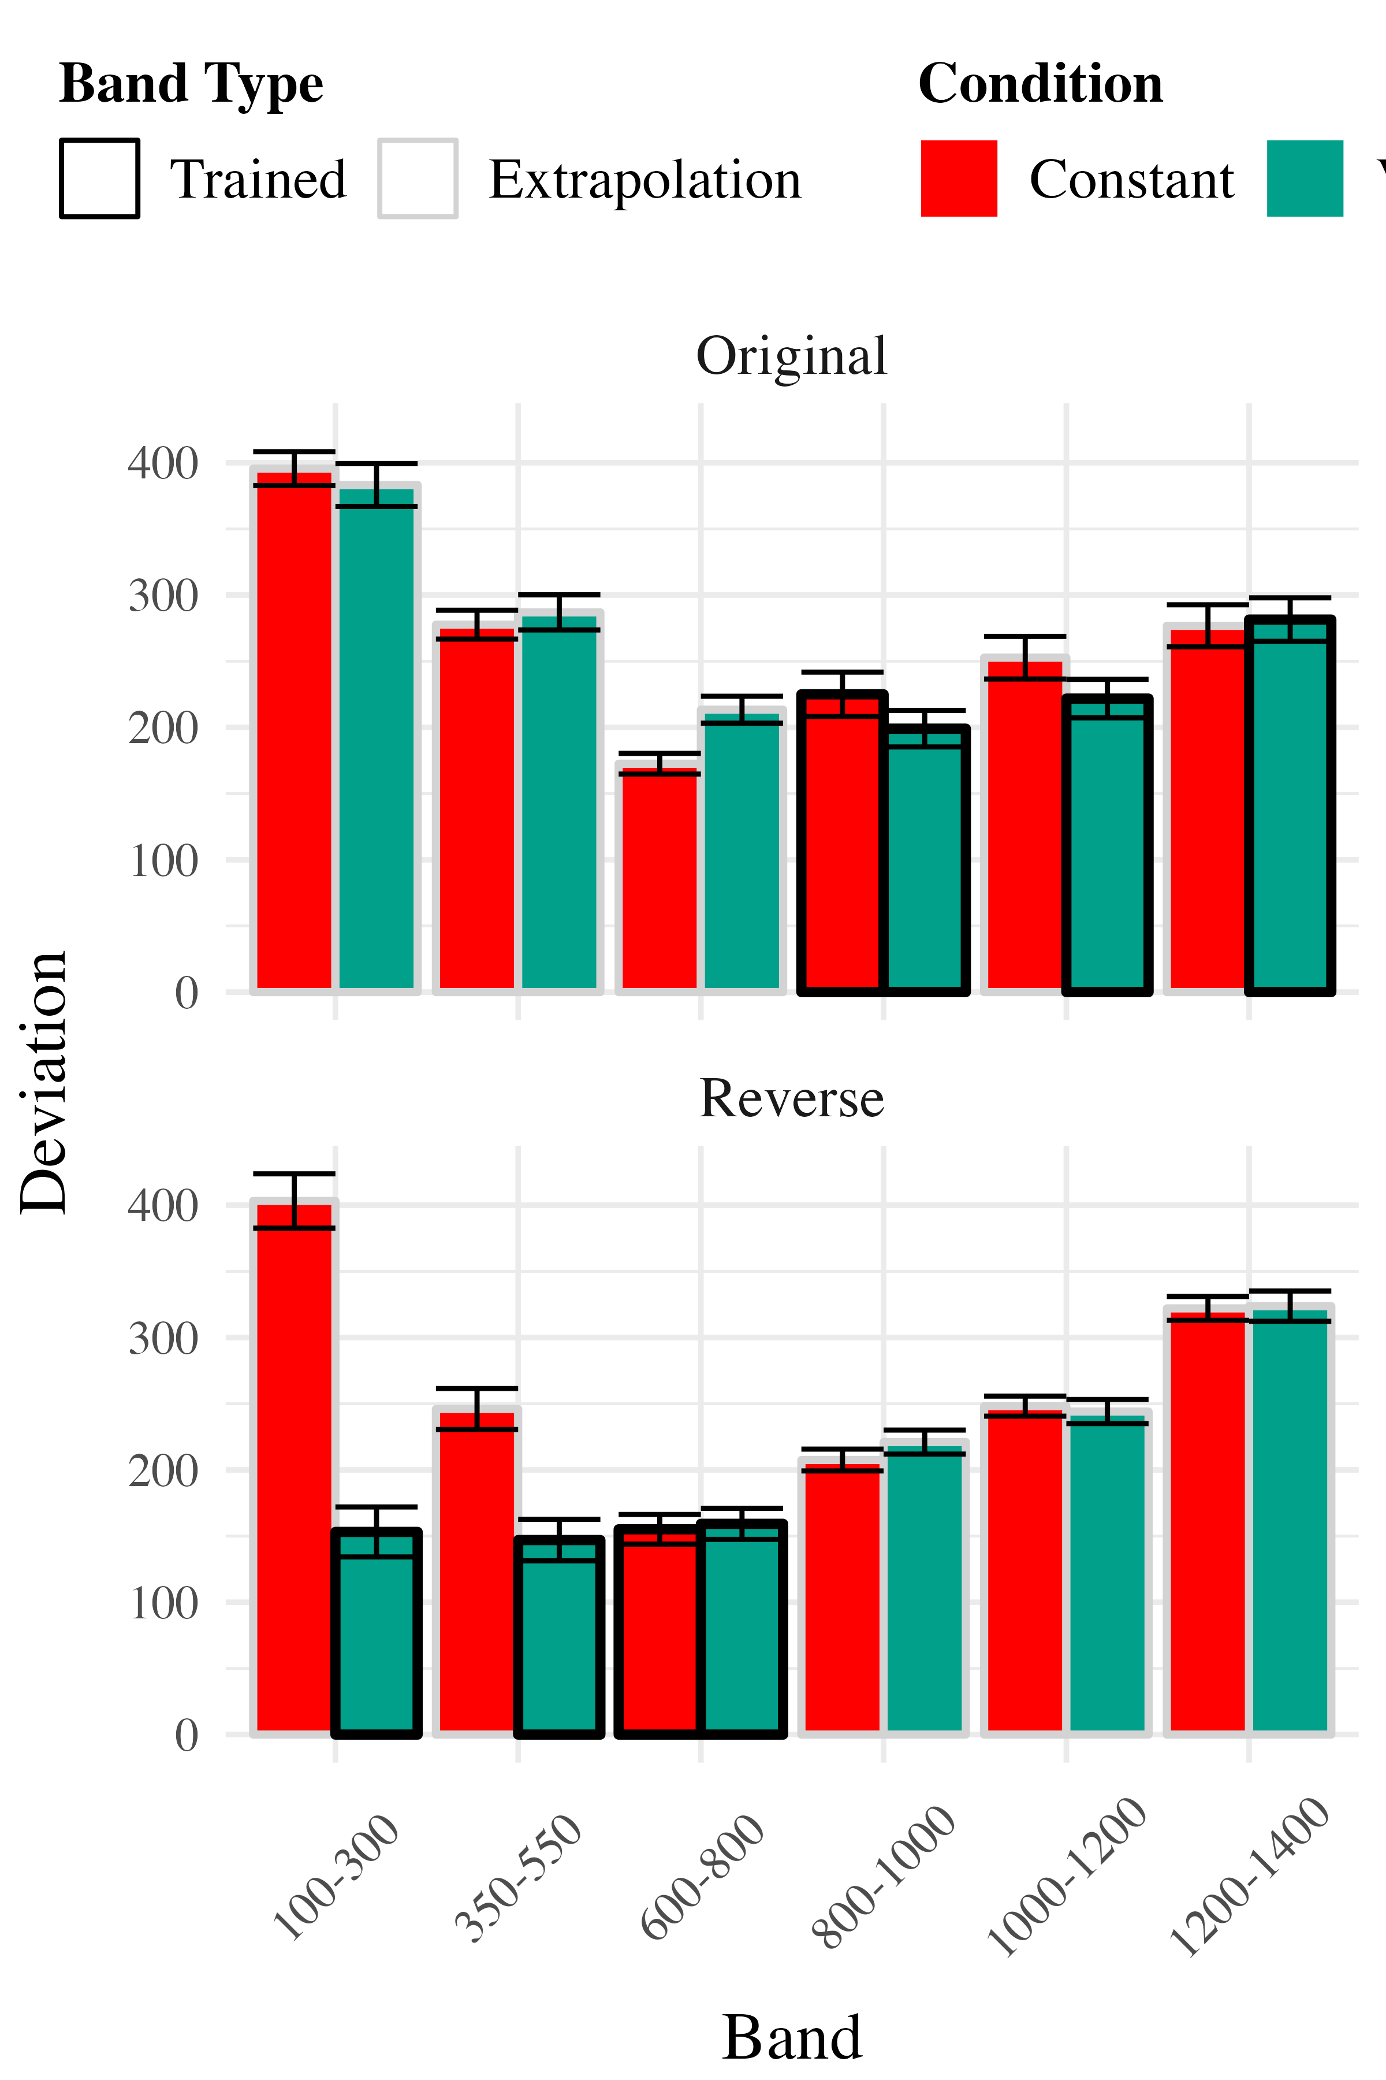
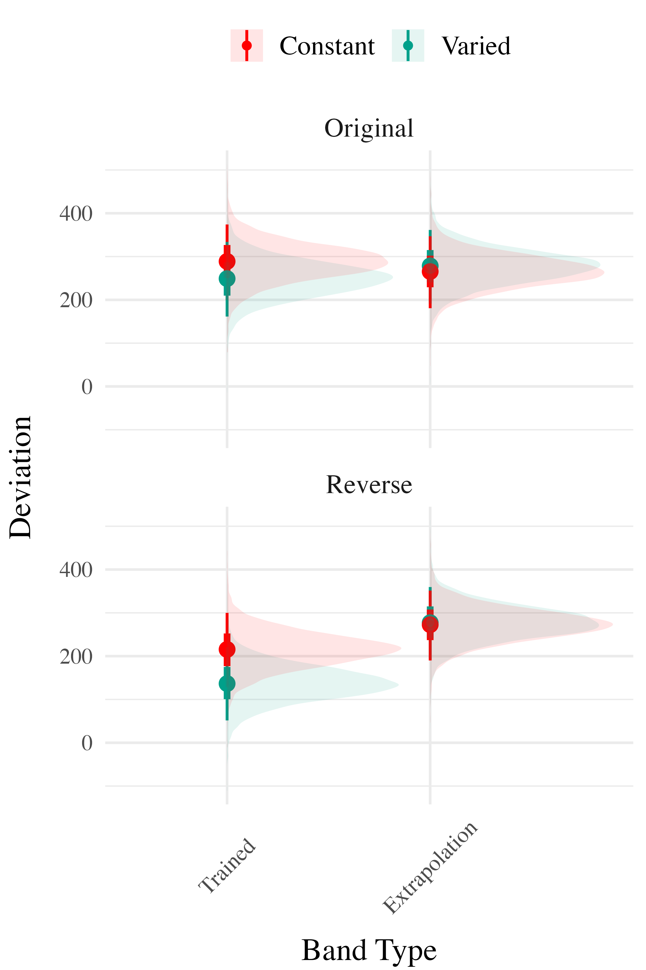

Slide 43
Experiment 3 - Discrimination

Slide 44
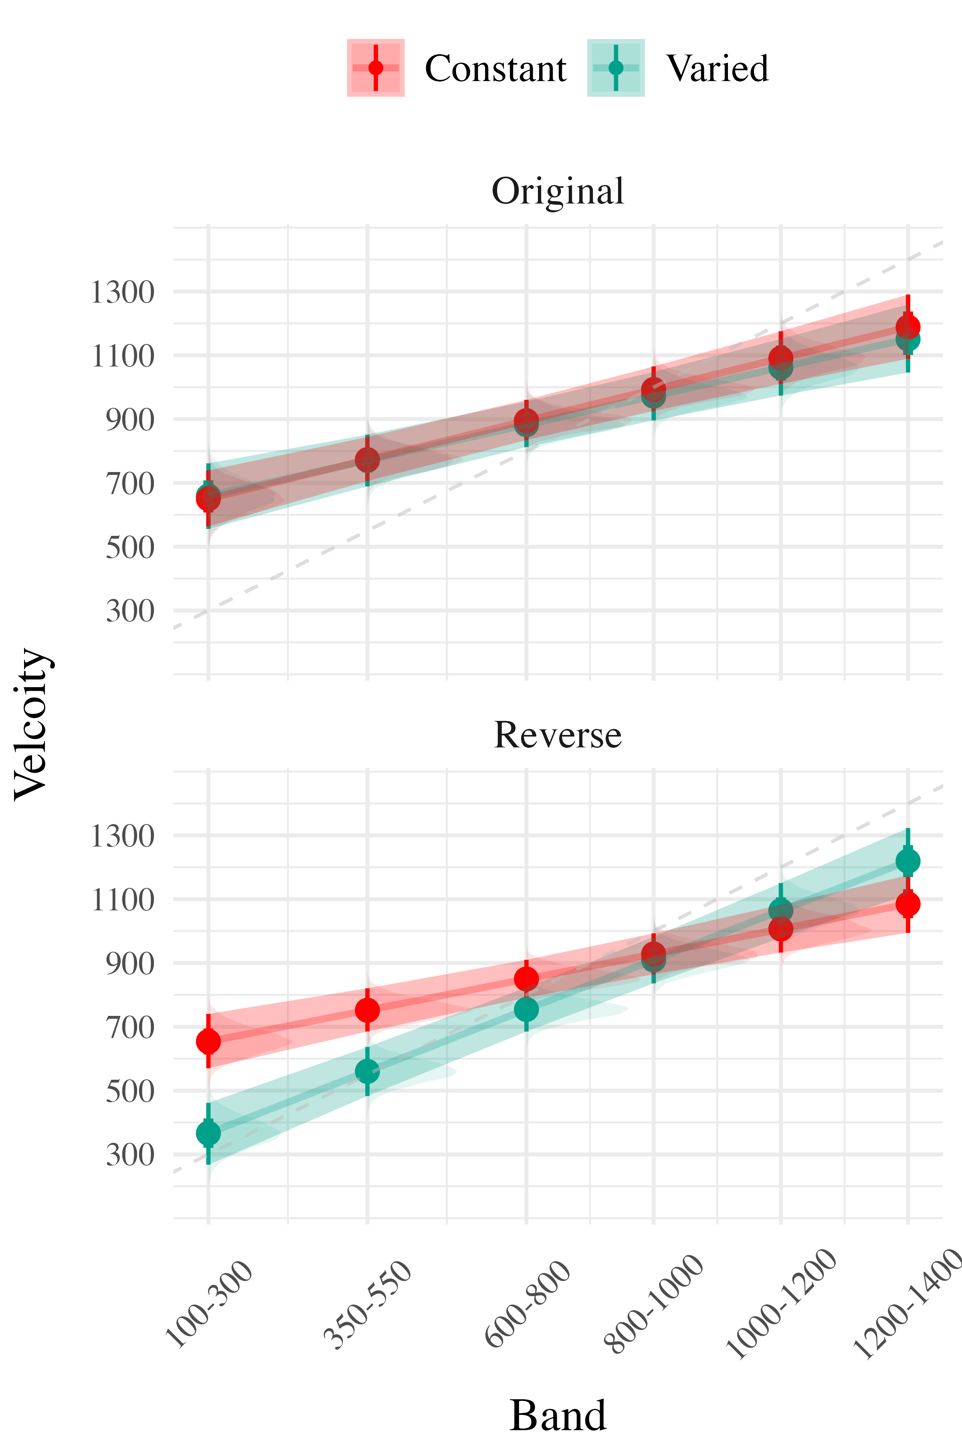
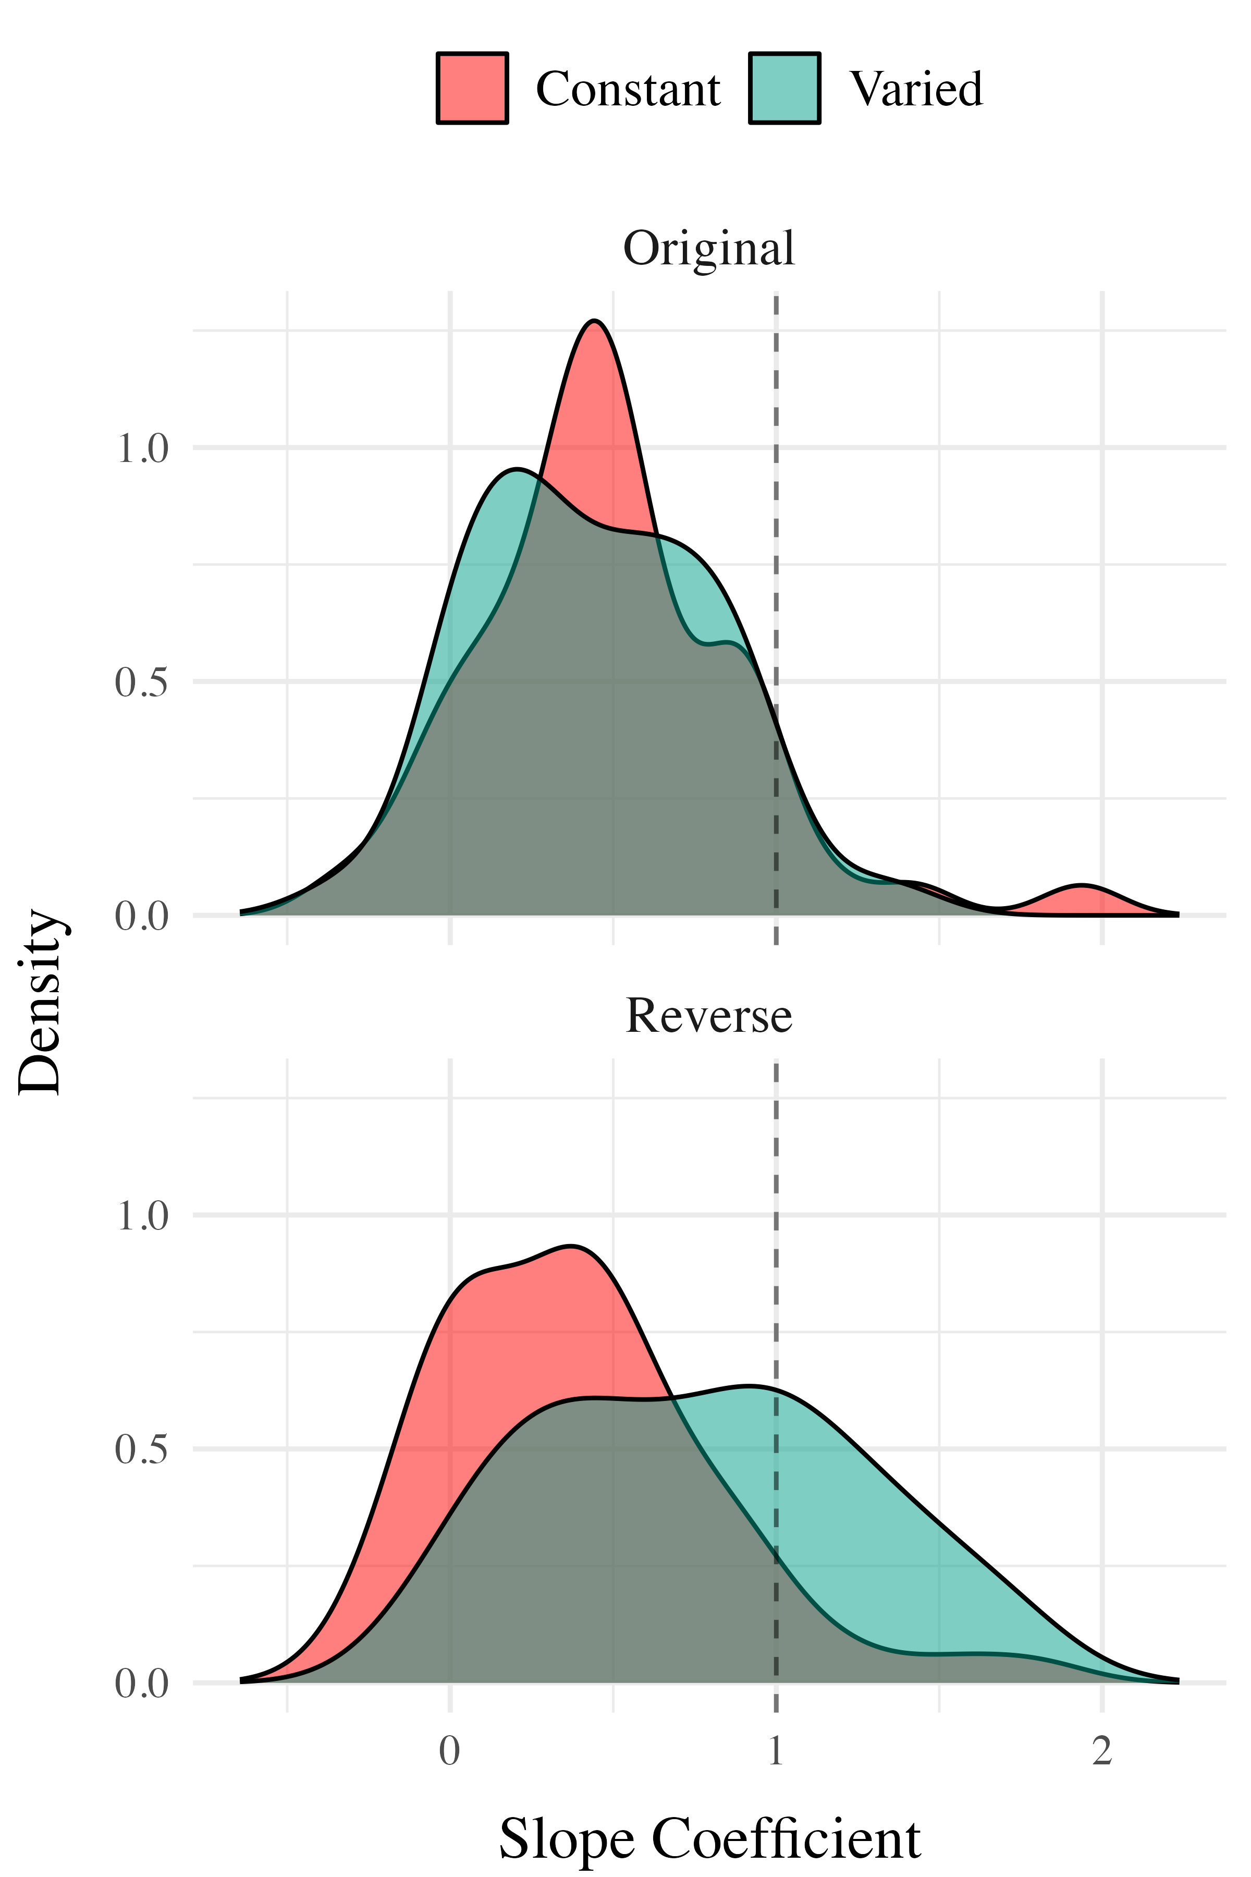

Slide 45
Project 2 - Computational Modeling
The Associative Learning Model ALM

Slide 46
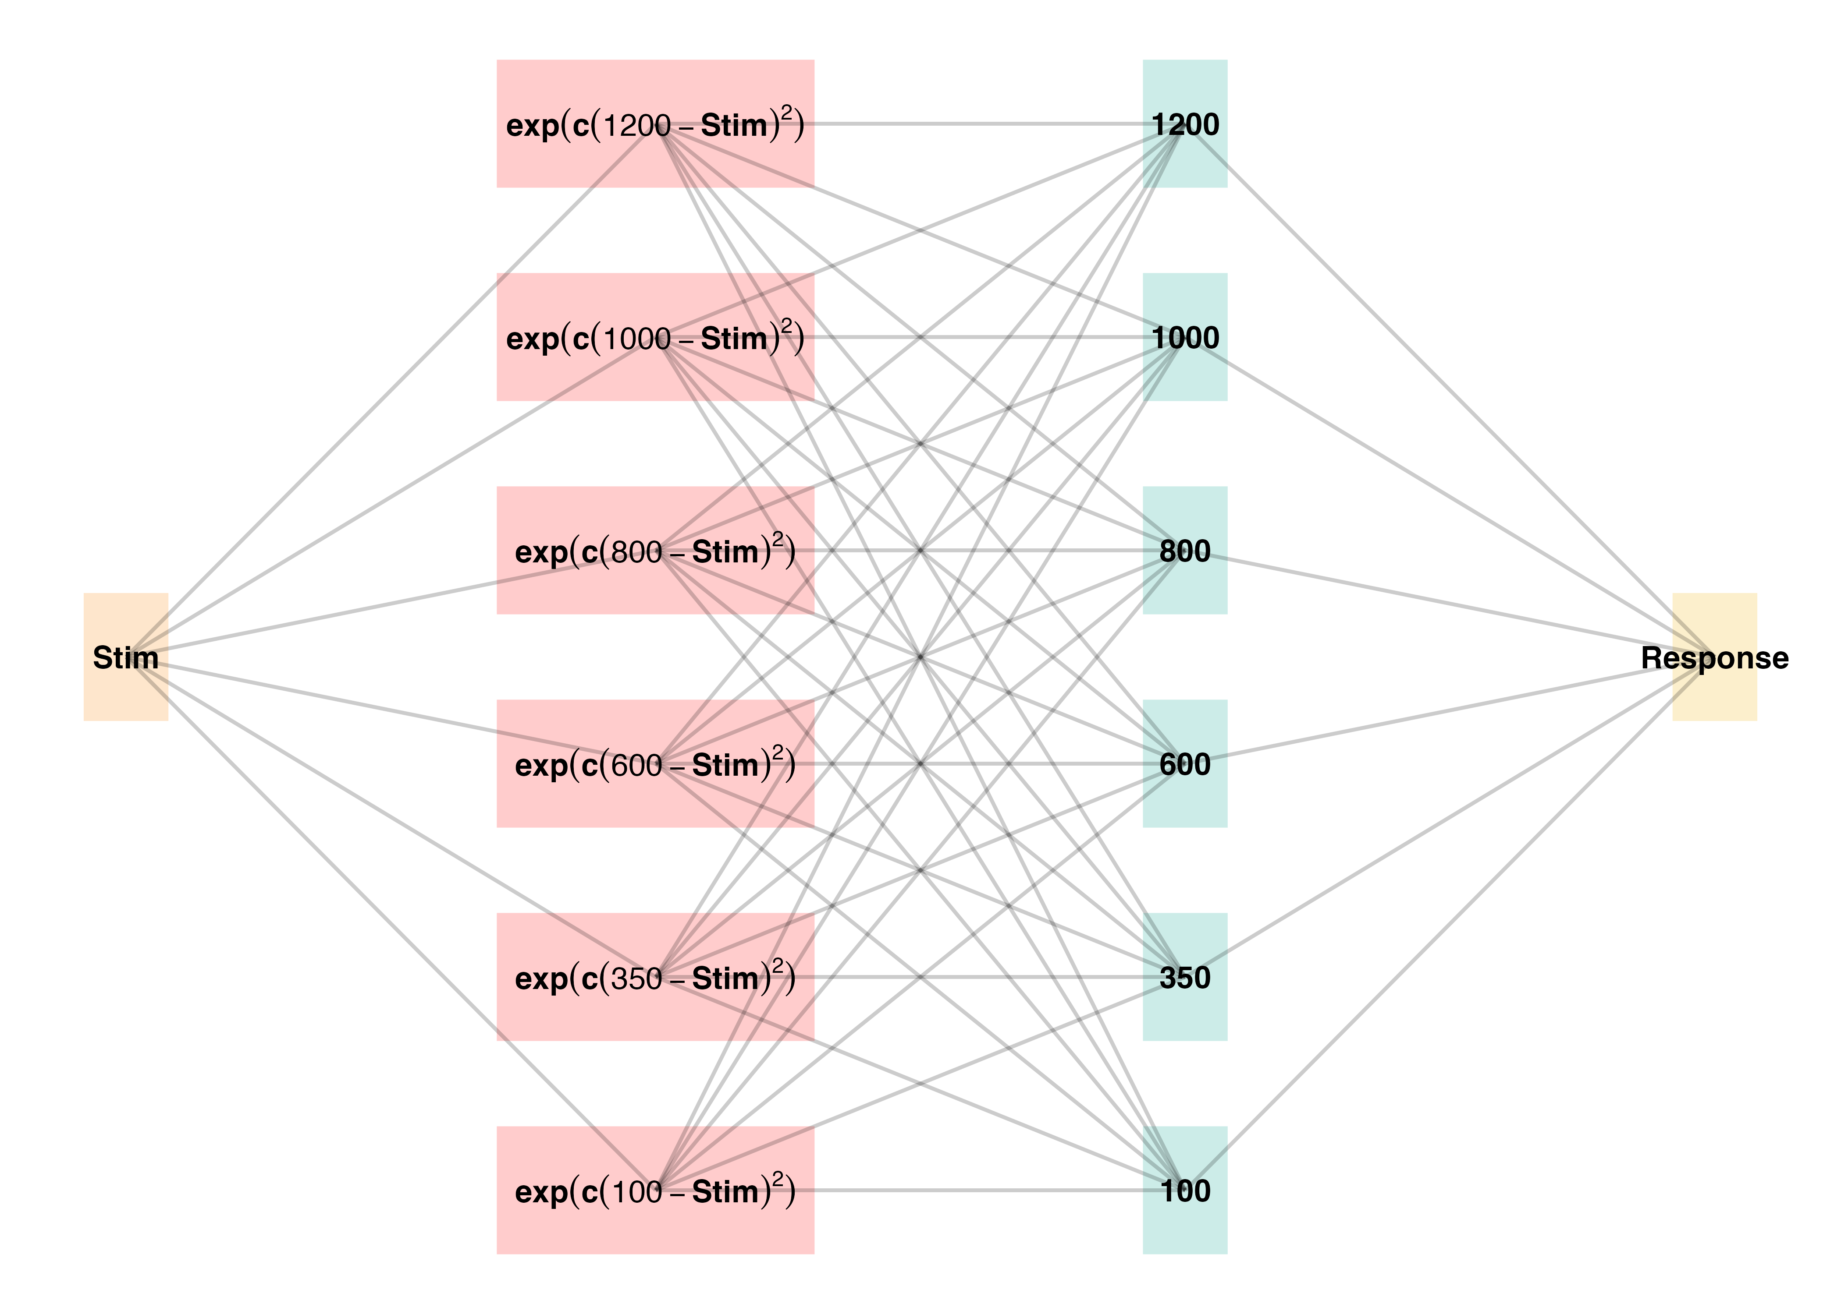
Two layer network - adapted from ALCOVE (Kruschke (1992))
Input layer node for each stimulus, output node for each response
Input nodes activate as a function of their Gaussian similarity to the stimulus
Weights udpated via delta rule - error driven learning
Provides good account of human learning data, and interpolation performance, but struggles with extrapolation (DeLosh et al., 1997)

Slide 47
 | EXAM Response Generation
Slope Computation | $S=\frac{m\left(X_{1}\right)−m\left(X_{2}\right)}{X_{1}−X_{2}}$ | Slope value, $S$ computed from nearest training instances
Response | $E\left[Y|X_{i}\right]=m\left(X_{i}\right)+S⋅\left[X−X_{i}\right]$ | Final EXAM response is the ALM response for the nearest training stimulus, $m\left(X_{i}\right)$, adjusted by local slope $S$.
Extrapolation - Association Model (EXAM)
Extension to ALM to account for human extrapolation behavior
When a novel stimulus is presented, EXAM assumes the nearest 2-3 prior examples are retrieved, and used to compute a slope
The slope is used to adjust the ALM response

Slide 48
Project 2 - Model Fitting Procedure
Approximate Bayesian Computation (ABC)

Slide 49
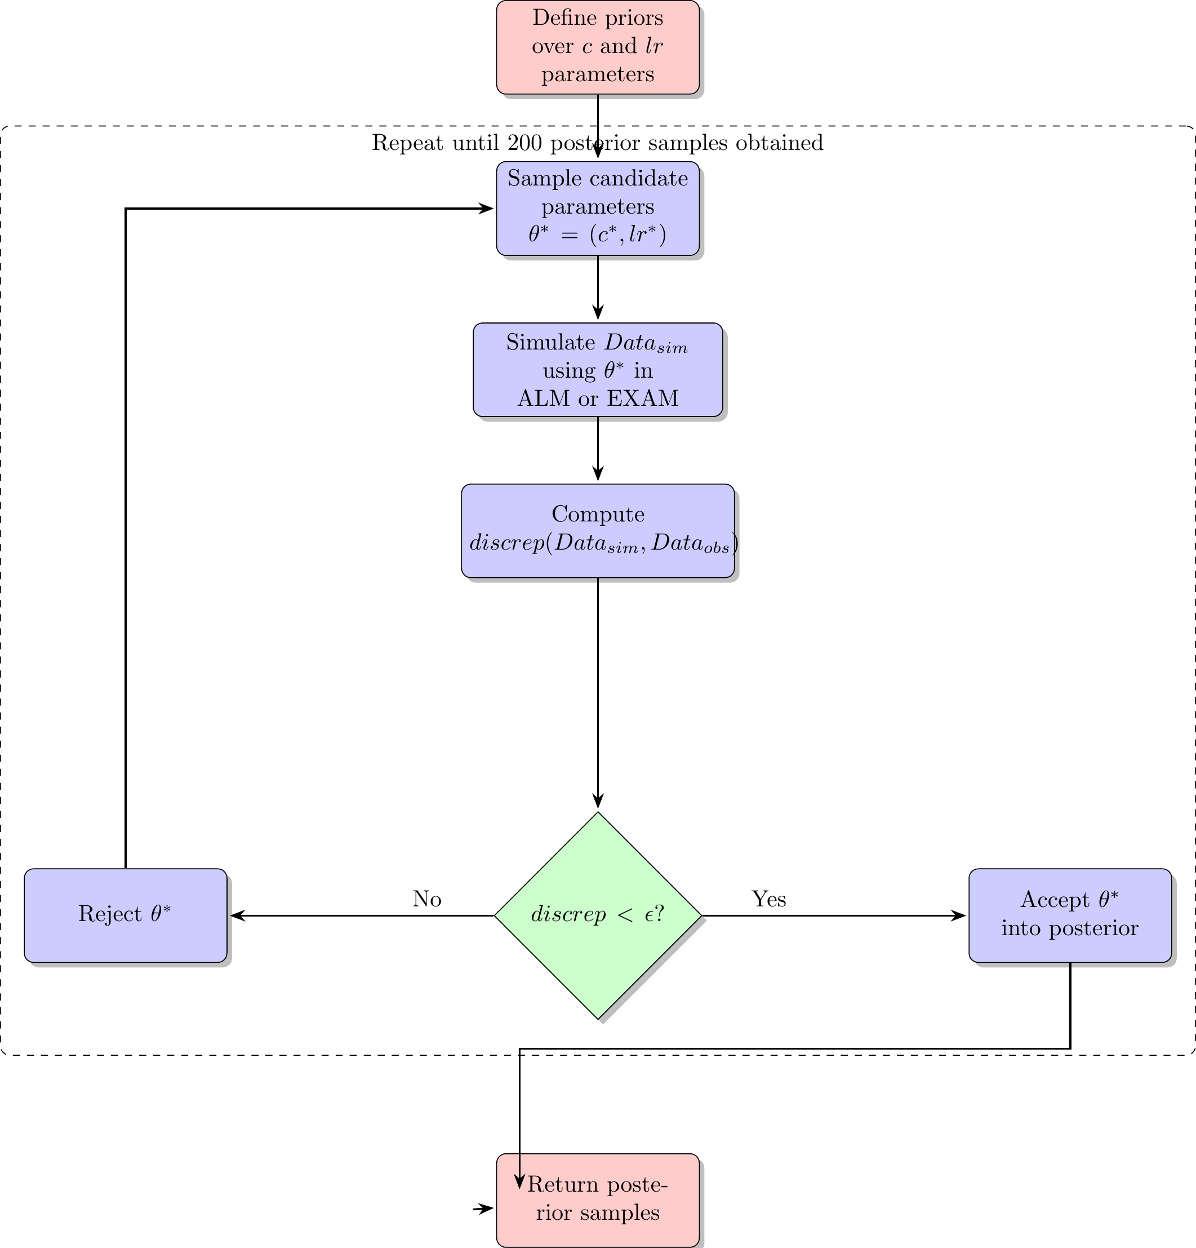
simulation based parameter estimation (Kangasrääsiö et al., 2019; Turner & Van Zandt, 2012)
Useful for models with unknown likelihood functions (e.g. many neural network and drift diffusion models)
full distribution of plausible model predictions for each participant

Slide 50
Project 2 - Model Fitting Procedure
Model Fitting Approach
Two parameters for both ALM and EXAM
generalization parameter: $c$
learning rate parameter: $lr$
ALM and EXAM fit separately to each individual participant
Rejection based ABC used to obtain 200 posterior samples, per participant, per model
i.e. 200 plausible values of $c$ and $lr$
All models fit with three different approaches
Fit to only the training data
Fit to both training and testing data
Fit to only testing data

Slide 51
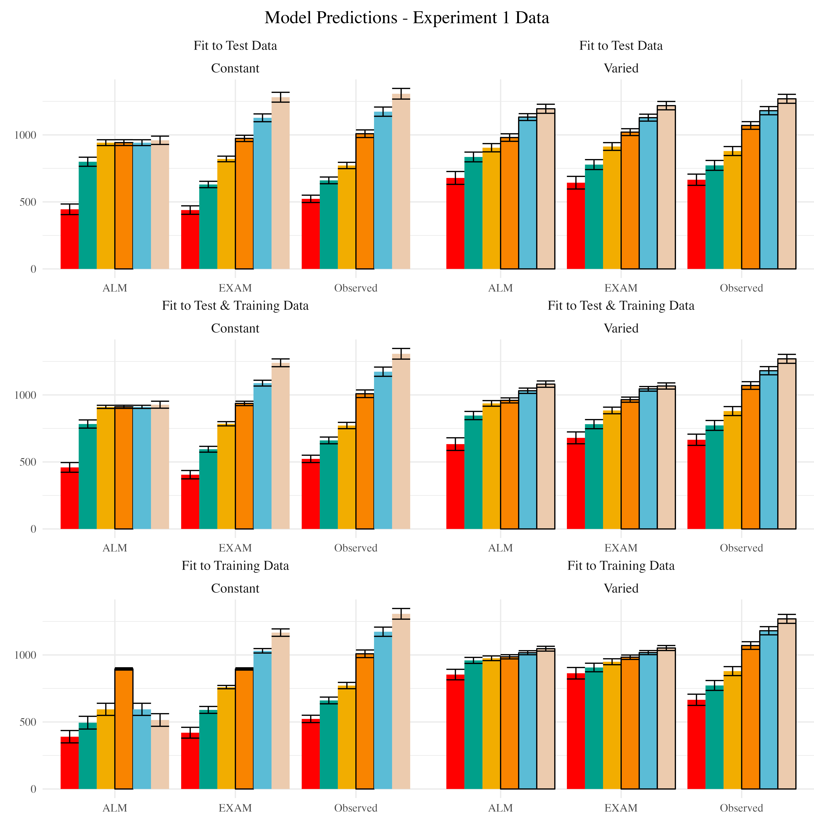
Modelling Results
Posterior Predictive Distribution
Notes:
Empirical data and Model predictions for mean velocity across target bands. Fitting methods (Test Only, Test & Train, Train Only) - are separated across rows, and Training Condition (Constant vs. Varied) are separated by columns. Each facet contains the predictions of ALM and EXAM, alongside the observed data.

Slide 52
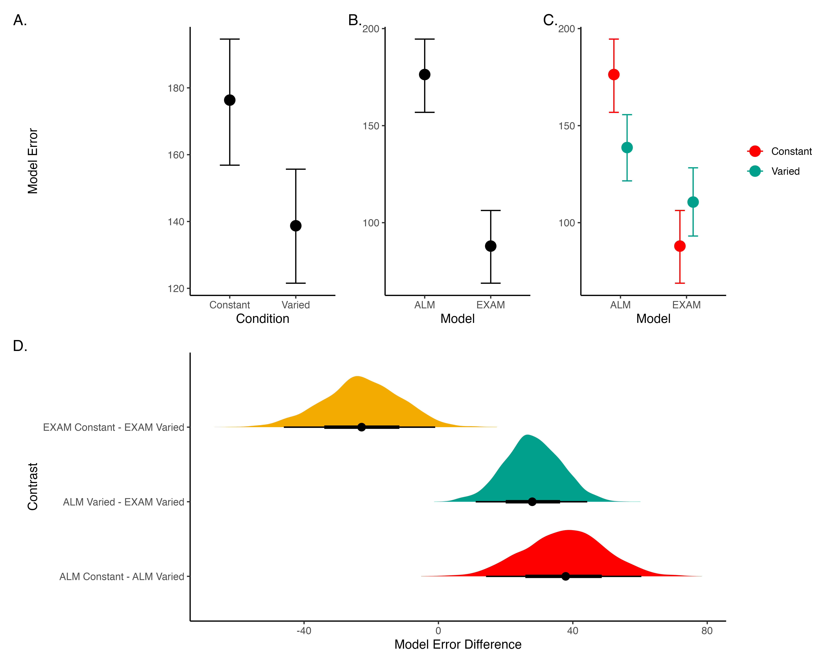
Model Comparison - Experiment 1
Notes:
Figure 21: A-C) Conditional effects of Model (ALM vs EXAM) and Condition (Constant vs. Varied). Lower values on the y axis indicate better model fit. D) Specific contrasts of model performance comparing 1) EXAM fits between constant and varied training; 2) ALM vs. EXAM for the varied group; 3) ALM fits between constant and varied. Negative error differences indicate that the term on the left side (e.g., EXAM Constant) tended to have smaller model residuals.

Slide 53
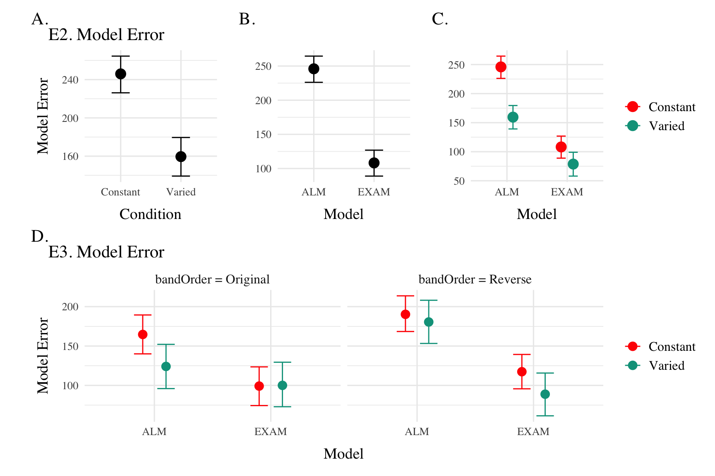
Model Comparison - Experiment 2 and 3
Notes:
Conditional effects of Model (ALM vs EXAM) and Condition (Constant vs. Varied) on Model Error for Experiment 2 and 3 data. Experiment 3 also includes a control for the order of training vs. testing bands (original order vs. reverse order).

Slide 54
Modelling Results
Best fitting models per participant
Notes:
Difference in model errors for each participant, with models fit to both train and test data. Positive values favor EXAM, while negative values favor ALM

Slide 55
General Discussion
Compare HTT and HTW
Empirical findings summary
Computational modeling contributions

Slide 56
Dimension | HTT (Project 1) | HTW (Project 2)
Task Description | Projectile launching to hit a target | Projectile launching to hit wall at a specific velocity
Task Complexity | More complex parabolic trajectory, both x and y velocities relevant to outcome | Simpler 1D mapping of force to outcome. Only x velocity is relevant.
Task Space | More complex: xy velocity combinations closer to the solution space may still result in worse feedback due to striking the barrier. | Simpler: smooth, linear mapping between velocity and feedback.
Perceptual salience of Varied Conditions | Varied conditions (# of throwing distances) are perceptually distinct, i.e. salient differences in distance between launching box and target. | Varied conditions (# of velocity bands) are less salient - only difference is the numeral displayed on screen.
Testing Feedback | Testing always included feedback | Primary testing stage had no feedback.
Potential for Learning during Testing | Limited potential for learning during testing due to feedback. | Some potential for learning during no-feedback testing by observing ball trajectory.
Training Experience | Varied group gets half as much experience on any one position as the constant group. | Varied group gets 1/3 as much experience on any one velocity band as the constant group.
Testing Structure | Random interleaving of trained/transfer testing distances. | Blocked structure, separately testing trained vs extrapolation testing bands.
Comparison

Slide 57
Conclusion
References
Bjork, E. L., & Bjork, R. A. (2011). Making things hard on yourself, but in a good way: Creating desirable difficulties to enhance learning. Psychology and the Real World: Essays Illustrating Fundamental Contributions to Society, 2, 59–68.
Chua, L.-K., Dimapilis, M. K., Iwatsuki, T., Abdollahipour, R., Lewthwaite, R., & Wulf, G. (2019). Practice variability promotes an external focus of attention and enhances motor skill learning. Human Movement Science, 64, 307–319. https://doi.org/10.1016/j.humov.2019.02.015
Del Rey, P., Wughalter, E. H., & Whitehurst, M. (1982). The Effects of Contextual Interference on Females With Varied Experience in Open Sport Skills. Research Quarterly for Exercise and Sport, 53(2), 108–115. https://doi.org/10.1080/02701367.1982.10605236
DeLosh, E. L., McDaniel, M. A., & Busemeyer, J. R. (1997). Extrapolation: The Sine Qua Non for Abstraction in Function Learning. Journal of Experimental Psychology: Learning, Memory, and Cognition, 23(4), 19. https://doi.org/10.1037/0278-7393.23.4.968
Gorman, T. E., & Goldstone, R. L. (2022). An instance-based model account of the benefits of varied practice in visuomotor skill. Cognitive Psychology, 137, 101491. https://doi.org/10.1016/j.cogpsych.2022.101491
Guadagnoli, M. A., & Lee, T. D. (2004). Challenge Point: A Framework for Conceptualizing the Effects of Various Practice Conditions in Motor Learning. Journal of Motor Behavior, 36(2), 212–224. https://doi.org/10.3200/JMBR.36.2.212-224
Kangasrääsiö, A., Jokinen, J. P. P., Oulasvirta, A., Howes, A., & Kaski, S. (2019). Parameter Inference for Computational Cognitive Models with Approximate Bayesian Computation. Cognitive Science, 43(6), e12738. https://doi.org/10.1111/cogs.12738
Kerr, R., & Booth, B. (1978). Specific and varied practice of motor skill. Perceptual and Motor Skills, 46(2), 395–401. https://doi.org/10.1177/003151257804600201
Kruschke, J. K. (1992). ALCOVE: An exemplar-based connectionist model of Category Learning. Psychological Review, 99(1). https://doi.org/10.1037/0033-295X.99.1.22
McCracken, H. D., & Stelmach, G. E. (1977). A Test of the Schema Theory of Discrete Motor Learning. Journal of Motor Behavior, 9(3), 193–201. https://doi.org/10.1080/00222895.1977.10735109
Schmidt, R. A. (1975). A schema theory of discrete motor skill learning. Psychological Review, 82(4), 225–260. https://doi.org/10.1037/h0076770
Turner, B. M., & Van Zandt, T. (2012). A tutorial on approximate Bayesian computation. Journal of Mathematical Psychology, 56(2), 69–85. https://doi.org/10.1016/j.jmp.2012.02.005

Slide 58
Extras

Slide 59
 | ALM Response Generation
Input Activation | $a_{i}\left(X\right)=\frac{e^{−c{\left(X−X_{i}\right)}^{2}}}{\sum_{k=1}^{M}{e^{−c{\left(X−X_{k}\right)}^{2}}}}$ | Input nodes activate as a function of Gaussian similarity to stimulus
Output Activation | $O_{j}\left(X\right)=\sum_{k=1}^{M}{w_{ji}}⋅a_{i}\left(X\right)$ | Output unit $O_{j}$ activation is the weighted sum of input activations and association weights
Output Probability | $P\left[Y_{j}|X\right]=\frac{O_{j}\left(X\right)}{\sum_{k=1}^{M}{O_{k}}\left(X\right)}$ | The response, $Y_{j}$ probabilites computed via Luce’s choice rule
Mean Output | $m\left(X\right)=\sum_{j=1}^{L}{Y_{j}}⋅\frac{O_{j}\left(x\right)}{\sum_{k=1}^{M}{O_{k}}\left(X\right)}$ | Weighted average of probabilities determines response to X
 | ALM Learning
Feedback | $f_{j}\left(Z\right)=e^{−c{\left(Z−Y_{j}\right)}^{2}}$ | feedback signal Z computed as similarity between ideal response and observed response
magnitude of error | $Δ_{ji}=\left(f_{j}\left(Z\right)−o_{j}\left(X\right)\right)a_{i}\left(X\right)$ | Delta rule to update weights.
Update Weights | $w_{ji}^{new}=w_{ji}+ηΔ_{ji}$ | Updates scaled by learning rate parameter $η$.
ALM

Slide 60
 | EXAM Response Generation
Instance Retrieval | $P\left[X_{i}|X\right]=\frac{a_{i}\left(X\right)}{\sum_{k=1}^{M}{a_{k}}\left(X\right)}$ | Novel test stimulus $X$ activates input nodes $X_{i}$
Slope Computation | $S=\frac{m\left(X_{1}\right)−m\left(X_{2}\right)}{X_{1}−X_{2}}$ | Slope value, $S$ computed from nearest training instances
Response | $E\left[Y|X_{i}\right]=m\left(X_{i}\right)+S⋅\left[X−X_{i}\right]$ | Final EXAM response is the ALM response for the nearest training stimulus, $m\left(X_{i}\right)$, adjusted by local slope $S$.
EXAM

Slide 61
Notes
1. Now published in Cognitive Psychology - (Gorman & Goldstone, 2022)

